Slide 1

Carly Beal and Katie Schneider
November 28th, 2023

Slide 2

Project Reasoning
New Concept | Old Interest
Deepening Cybersecurity Understanding | Skill Development

Slide 3
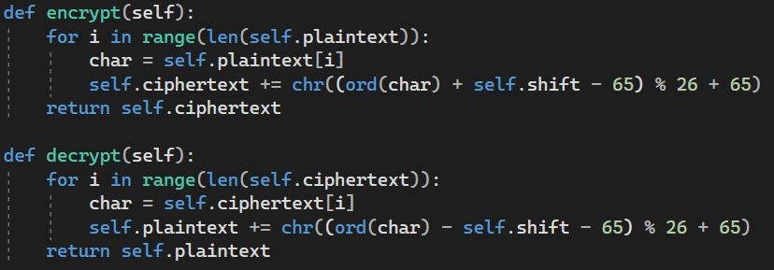
Caesar
Monoalphabetic
Playfair
Vigenère
Hill
S-DES
A B C D E F G H I J K L M N O P Q R S T U V W X Y Z
A B C D E F G H I J K L M N O P Q R S T U V W X Y Z
A B C D E F G H I J K L M N O P Q R S T U V W X Y Z
A B C D E F G H I J K L M N O P Q R S T U V W X Y Z
A B C D E F G H I J K L M N O P Q R S T U V W X Y Z

Slide 4
Caesar
Monoalphabetic
Playfair
Playfair
Vigenère
Vigenère
Hill
Hill
S-DES
S-DES
M
E
E
T
A B C D E F G H I J K L M N O P Q R S T U V W X Y Z
A B C D E F G H I J K L M N O P Q R S T U V W X Y Z
A B C D E F G H I J K L M N O P Q R S T U V W X Y Z
A B C D E F G H I J K L M N O P Q R S T U V W X Y Z

Slide 5
Caesar
Monoalphabetic
Playfair
Vigenère
Hill
S-DES
Shift = 6
S
K
K
Z
A B C D E F G H I J K L M N O P Q R S T U V W X Y Z
A B C D E F G H I J K L M N O P Q R S T U V W X Y Z
A B C D E F G H I J K L M N O P Q R S T U V W X Y Z
A B C D E F G H I J K L M N O P Q R S T U V W X Y Z

Slide 6
Caesar
Monoalphabetic
Playfair
Playfair
Vigenère
Vigenère
Hill
Hill
S-DES
S-DES
Shift = -6
M
E
E
T
A B C D E F G H I J K L M N O P Q R S T U V W X Y Z
A B C D E F G H I J K L M N O P Q R S T U V W X Y Z
A B C D E F G H I J K L M N O P Q R S T U V W X Y Z
A B C D E F G H I J K L M N O P Q R S T U V W X Y Z

Slide 7
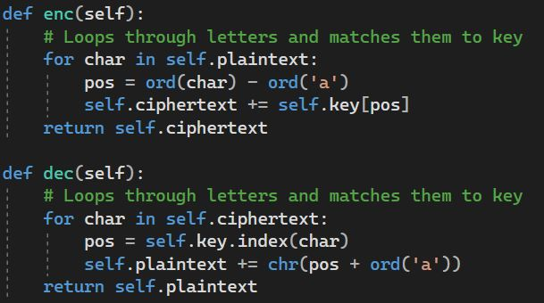
Caesar
Monoalphabetic
Playfair
Vigenère
Hill
S-DES
Q
Q
A
W
W
B
E
E
C
R
R
D
T
T
E
Y
Y
F
U
U
G
I
I
H
O
O
I
P
P
J
A
A
K
S
S
L
D
D
M
F
F
N
G
G
O
H
H
P
J
J
Q
K
K
R
L
L
S
Z
Z
T
X
X
U
C
C
V
V
V
W
B
B
X
N
N
Y
M
M
Z

Slide 8
Caesar
Monoalphabetic
Playfair
Vigenère
Hill
S-DES
A
B
C
D
E
F
G
H
I
J
K
L
M
N
O
P
Q
R
S
T
U
V
W
X
Y
Z
Q
W
E
R
T
Y
U
I
O
P
A
S
D
F
G
H
J
K
L
Z
X
C
V
B
N
M

Slide 9
Playfair
Vigenère
Hill
S-DES
P | L | A | Y | F
I/J | R | B | C | D
E | G | H | K | M
N | O | Q | S | T
U | V | W | X | Z
Rules:
Same row: Shift one right
Same column: Shift one below
Else: form rectangle, shift corners
Irregularities:
Repeating letters / odd message length
Insert the filler letter ‘X’

Slide 10
Playfair
Vigenère
Hill
S-DES
Keyword: Playfair
Keyword: PLAYFAIR
Message: Meet me at night
Message: ME ET ME AT NI GH TX
P | L | A | Y | F
I/J | R | B | C | D
E | G | H | K | M
N | O | Q | S | T
U | V | W | X | Z

Slide 11
Playfair
Vigenère
Hill
S-DES
Keyword: PLAYFAIR
Message: ME ET ME AT NI GH TX
P | L | A | Y | F
I/J | R | B | C | D
E | G | H | K | M
N | O | Q | S | T
U | V | W | X | Z
Ciphertext: EG

Slide 12
Playfair
Vigenère
Hill
S-DES
Keyword: PLAYFAIR
Message: ME ET ME AT NI GH TX
P | L | A | Y | F
I/J | R | B | C | D
E | G | H | K | M
N | O | Q | S | T
U | V | W | X | Z
Ciphertext: EG MN

Slide 13
Playfair
Vigenère
Hill
S-DES
Keyword: PLAYFAIR
Message: ME ET ME AT NI GH TX
P | L | A | Y | F
I/J | R | B | C | D
E | G | H | K | M
N | O | Q | S | T
U | V | W | X | Z
Ciphertext: EG MN EG

Slide 14
Playfair
Vigenère
Hill
S-DES
Keyword: PLAYFAIR
Message: ME ET ME AT NI GH TX
P | L | A | Y | F
I/J | R | B | C | D
E | G | H | K | M
N | O | Q | S | T
U | V | W | X | Z
Ciphertext: EG MN EG FQ

Slide 15
Playfair
Vigenère
Hill
S-DES
Keyword: PLAYFAIR
Message: ME ET ME AT NI GH TX
P | L | A | Y | F
I/J | R | B | C | D
E | G | H | K | M
N | O | Q | S | T
U | V | W | X | Z
Ciphertext: EG MN EG FQ UE

Slide 16
Playfair
Vigenère
Hill
S-DES
Keyword: PLAYFAIR
Message: ME ET ME AT NI GH TX
P | L | A | Y | F
I/J | R | B | C | D
E | G | H | K | M
N | O | Q | S | T
U | V | W | X | Z
Ciphertext: EG MN EG FQ UE HK

Slide 17
Playfair
Vigenère
Hill
S-DES
Keyword: PLAYFAIR
Message: ME ET ME AT NI GH TX
P | L | A | Y | F
I/J | R | B | C | D
E | G | H | K | M
N | O | Q | S | T
U | V | W | X | Z
Ciphertext: EG MN EG FQ UE HK SZ

Slide 18
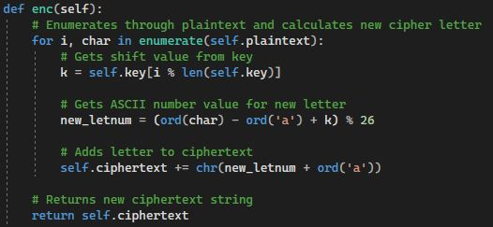
Playfair
Vigenère
Hill
S-DES
A
B
C
D
E
F
G
H
I
J
K
L
M
N
O
P
Q
R
S
T
U
V
W
X
Y
Z
A
B
C
D

Slide 19
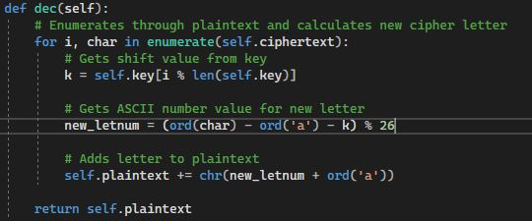
Playfair
Vigenère
Hill
S-DES
A
B
C
D
E
F
G
H
I
J
K
L
M
N
O
P
Q
R
S
T
U
V
W
X
Y
Z
A
B
C
D
Y
Z
A
B
C
D
E
F
G
H
I
J
K
L
M
N
O
P
Q
R
S
T
U
V
W
X
Y
Z
A
B
C
D
E
F
G
H
I
R
S
T
U
V
W
X
Y
Z
A
B
C
D
E
F
G
H
I
J
K
L
M
N
O
P
Q
R
S
T
U
V
W
X
Y
Z

Slide 20
Playfair
Vigenère
Hill
S-DES
C
CATASTROPHE
CAT AST ROP HEX
A
B
C
D
E
F
G
H
I
J
K
L
M
N
O
P
Q
R
S
T
U
V
W
X
Y
Z
A
B
C
D
A
KEY = DLI
Y
Z
A
B
C
D
E
F
G
H
I
J
K
L
M
N
O
P
Q
R
S
T
U
V
W
X
Y
Z
A
B
C
D
E
F
G
H
I
J
T
R
S
T
U
V
W
X
Y
Z
A
B
C
D
E
F
G
H
I
J
K
L
M
N
O
P
Q
R
S
T
U
V
W
X
Y
Z

Slide 21
Playfair
Vigenère
Hill
S-DES
F
Shift = 3 (D)
A
B
C
D
E
F
G
H
I
J
K
L
M
N
O
P
Q
R
S
T
U
V
W
X
Y
Z
A
B
C
D
L
Shift = 11 (L)
KEY = DLI
Y
Z
A
B
C
D
E
F
G
H
I
J
K
L
M
N
O
P
Q
R
S
T
U
V
W
X
Y
Z
A
B
C
D
E
F
G
H
I
J
B
Shift = 8 (I)
Ciphertext
FLB
R
S
T
U
V
W
X
Y
Z
A
B
C
D
E
F
G
H
I
J
K
L
M
N
O
P
Q
R
S
T
U
V
W
X
Y
Z

Slide 22
Playfair
Vigenère
Hill
S-DES
G | Y | B
N | Q | K
U | R | P
A
C
T
P
O
H
Key Matrix
Message Block
Cipher Block

Slide 23
Playfair
Vigenère
Hill
S-DES
G | Y | B
N | Q | K
U | R | P
A
C
T
P
O
H
I | F | K
V | I | V
V | M | I
6 | 24 | 1
13 | 16 | 10
20 | 17 | 15
0
2
19
15
14
7
8 | 5 | 10
21 | 8 | 21
21 | 12 | 8

Slide 24
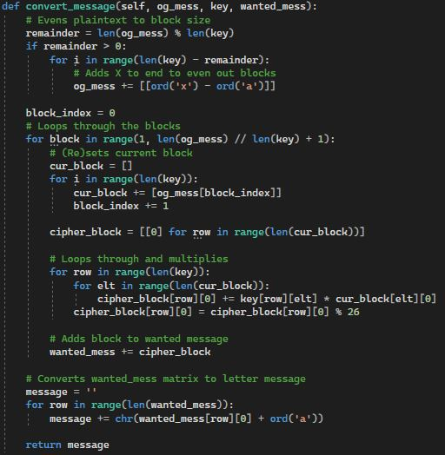
Playfair
Vigenère
Hill
S-DES

Slide 25
Playfair
Vigenère
Hill
S-DES
K
M
C
P10
IP
IP⁻¹
10-bit Key: 1010000010
LS1
LS1
f_{k}
f_{k}
P8
SW
SW
8-bit Plaintext Message:
10010111
f_{k}
LS2
LS2
f_{k}
IP⁻¹
P8
IP
C
M

Slide 26
Playfair
Vigenère
Hill
S-DES
Generate Subkeys:
P10:
3 | 5 | 2 | 7 | 4 | 10 | 1 | 9 | 8 | 6
Key:
1 | 0 | 1 | 0 | 0 | 0 | 0 | 0 | 1 | 0
P10 Key:
1 | 0 | 0 | 0 | 0 | 0 | 1 | 1 | 0 | 0

Slide 27
Playfair
Vigenère
Hill
S-DES
Split the key:
Left:
1 | 0 | 0 | 0 | 0
Right:
0 | 1 | 1 | 0 | 0
Circular Left Shift (LS-1):
Left:
0 | 0 | 0 | 0 | 1
Right:
1 | 1 | 0 | 0 | 0
Put together:
Left + Right:
0 | 0 | 0 | 0 | 1 | 1 | 1 | 0 | 0 | 0

Slide 28
Playfair
Vigenère
Hill
S-DES
P8:
6 | 3 | 7 | 4 | 8 | 5 | 10 | 9
Left + Right:
0 | 0 | 0 | 0 | 1 | 1 | 1 | 0 | 0 | 0
Subkey1:
1 | 0 | 1 | 0 | 0 | 1 | 0 | 0

Slide 29
Playfair
Vigenère
Hill
S-DES
Split LS-1:
Left:
0 | 0 | 0 | 0 | 1
Right:
1 | 1 | 0 | 0 | 0
Circular Left Shift 2 (LS-2):
Left:
0 | 0 | 1 | 0 | 0
Right:
0 | 0 | 0 | 1 | 1
Put together:
Left + Right:
0 | 0 | 1 | 0 | 0 | 0 | 0 | 0 | 1 | 1

Slide 30
Playfair
Vigenère
Hill
S-DES
P8:
6 | 3 | 7 | 4 | 8 | 5 | 10 | 9
Left + Right:
0 | 0 | 1 | 0 | 0 | 0 | 0 | 0 | 1 | 1
Subkey2:
0 | 1 | 0 | 0 | 0 | 0 | 1 | 1

Slide 31
Playfair
Vigenère
Hill
S-DES
IP:
2 | 6 | 3 | 1 | 4 | 8 | 5 | 7
PT:
1 | 0 | 0 | 1 | 0 | 1 | 1 | 1
IP of PT:
0 | 1 | 0 | 1 | 1 | 1 | 0 | 1

Slide 32
Playfair
Vigenère
Hill
S-DES
Now: The F_K function
IP of PT:
0 | 1 | 0 | 1 | 1 | 1 | 0 | 1
Left:
0 | 1 | 0 | 1
Right:
1 | 1 | 0 | 1
EP:
4 | 1 | 2 | 3 | 2 | 3 | 4 | 1
EP of Right:
1 | 1 | 1 | 0 | 1 | 0 | 1 | 1

Slide 33
Playfair
Vigenère
Hill
S-DES
Perform XOR using Subkey1 and EP of Right:
Subkey1:
1 | 0 | 1 | 0 | 0 | 1 | 0 | 0
EP of Right:
1 | 1 | 1 | 0 | 1 | 0 | 1 | 1
XOR output:
0 | 1 | 0 | 0 | 1 | 1 | 1 | 1
Left:
0 | 1 | 0 | 0
Right:
1 | 1 | 1 | 1

Slide 34
Playfair
Vigenère
Hill
S-DES
Column: 1st & 4th bit
Row: 2nd & 3rd bit
Left:
0 | 1 | 0 | 0
Row:
0 | 0 | = | 0
1 | 0 | 3 | 2
3 | 2 | 1 | 0
0 | 2 | 1 | 3
3 | 1 | 3 | 2
Col:
1 | 0 | = | 2
S0:
S0:
3 | = | 1 | 1
Right:
1 | 1 | 1 | 1
0 | 1 | 2 | 3
2 | 0 | 1 | 3
3 | 0 | 1 | 0
2 | 1 | 0 | 3
Row:
1 | 1 | = | 3
S1:
Col:
1 | 1 | = | 3
S1:
3 | = | 1 | 1

Slide 35
Playfair
Vigenère
Hill
S-DES
S0 + S1:
1 | 1 | 1 | 1
P4:
2 | 4 | 3 | 1
Permute S0 + S1 with P4:
1 | 1 | 1 | 1
XOR this with left half of the IP
0 | 1 | 0 | 1
XOR
1 | 1 | 1 | 1
XOR Output:
1 | 0 | 1 | 0

Slide 36
Playfair
Vigenère
Hill
S-DES
XOR Output:
1 | 0 | 1 | 0
Right of IP:
1 | 1 | 0 | 1
Combine right of IP and the XOR output:
1 | 0 | 1 | 0 | 1 | 1 | 0 | 1
Divide and switch:
1 | 1 | 0 | 1 | 1 | 0 | 1 | 0

Slide 37
Playfair
Vigenère
Hill
S-DES
Now: The F_K function again
1 | 1 | 0 | 1 | 1 | 0 | 1 | 0
Left:
1 | 1 | 0 | 1
Right:
1 | 0 | 1 | 0
EP:
4 | 1 | 2 | 3 | 2 | 3 | 4 | 1
EP of Right:
0 | 1 | 0 | 1 | 0 | 1 | 0 | 1

Slide 38
Playfair
Vigenère
Hill
S-DES
Perform XOR using Subkey2 and EP of Right:
Subkey2:
0 | 1 | 0 | 0 | 0 | 0 | 1 | 1
EP of Right:
0 | 1 | 0 | 1 | 0 | 1 | 0 | 1
XOR output:
0 | 0 | 0 | 1 | 0 | 1 | 1 | 0
Left:
0 | 0 | 0 | 1
Right:
0 | 1 | 1 | 0

Slide 39
Playfair
Vigenère
Hill
S-DES
Column: 1st & 4th bit
Row: 2nd & 3rd bit
Left:
0 | 0 | 0 | 1
1 | 0 | 3 | 2
3 | 2 | 1 | 0
0 | 2 | 1 | 3
3 | 1 | 3 | 2
Row:
0 | 1 | = | 1
Col:
0 | 0 | = | 0
S0:
S0:
3 | = | 1 | 1
Right:
0 | 1 | 1 | 0
0 | 1 | 2 | 3
2 | 0 | 1 | 3
3 | 0 | 1 | 0
2 | 1 | 0 | 3
Row:
0 | 0 | = | 0
S1:
Col:
1 | 1 | = | 3
S1:
3 | = | 1 | 1

Slide 40
Playfair
Vigenère
Hill
S-DES
S0 + S1:
1 | 1 | 1 | 1
P4:
2 | 4 | 3 | 1
Permute S0 + S1 with P4:
1 | 1 | 1 | 1
XOR this with left half of the IP
1 | 1 | 0 | 1
XOR
1 | 1 | 1 | 1
XOR Output:
0 | 0 | 1 | 0

Slide 41
Playfair
Vigenère
Hill
S-DES
XOR Output:
0 | 0 | 1 | 0
I’m calling you
Right of IP:
1 | 0 | 1 | 0
Combine right of IP and the XOR output:
0 | 0 | 1 | 0 | 1 | 0 | 1 | 0
Inverse IP:
4 | 1 | 3 | 5 | 7 | 2 | 8 | 6
Perform IP-1 on this:
0 | 0 | 1 | 1 | 1 | 0 | 0 | 0
Ciphertext:
0 | 0 | 1 | 1 | 1 | 0 | 0 | 0

Slide 42
Time Issues & Unexpected Issues
Time Estimation Issues:
Severely underestimated S-DES
Severely underestimated Hill
Unexpected Issues:
The mathematical calculations for S-DES
Input validation
Modulus Inverse vs. Actual Inverse

Slide 43
Demonstration Loading….

Slide 44

Thank
you!

